Slide 1

Road Damage Detection Using SAM Segmentation & YOLOv11m
FOR
Deep Learning for Image Analysis(CUML1022)
“Under The Supervision Of”
DR. Chinmayee Dora
PRESENTED BY:-
Chinmaya Sahu (230301120220)
Arup Pattnaik (230301120224)
Sarbajeet Muduli (230301120242)
Sanjeev Swain (230301120254)
Ayman Ahmed (230301120285)

Slide 2
MEMBERS CONTRIBUTION
Sarbajeet Muduli ( 230301120242 ) :-
Model Development & Training — Implemented YOLOv11m architecture, fine-tuned model parameters, and analyzed training performance (losses, mAP, precision, recall).
Chinmaya Sahu ( 230301120220 ) :-
Data Preparation & Preprocessing — Collected and cleaned road damage datasets (RDD2022), annotated data, split training/validation sets, and performed augmentation.
Arup Pattnaik ( 230301120224 ) :-
Integration & Optimization — Combined YOLOv11m with SAM segmentation model, optimized inference speed, and implemented post-processing for final mask visualization
Sanjeev Swain ( 230301120254 ) :-
Presentation, Documentation & Results Visualization — Prepared PowerPoint, summarized methodology, created charts (loss curves, detection visuals), and wrote final report.
Ayman Ahmed ( 230301120285 ):-
Experimental Setup & Evaluation — Configured training environment (Software), monitored model training, evaluated confusion matrices, and PR curves.

Slide 3
OUTLINE:-
Introduction
Dataset Description
Experimental Setup
Methodology
Model Workflow
Results

Slide 4
INTRODUCTION
Problem Statement:-
Road damages such as cracks, potholes, and surface deformations directly affect road safety and driving comfort.
Traditional inspection methods are manual, time-consuming, and error-prone, making large-scale monitoring impractical.
Motivation:
The need for an automated, real-time, and accurate system to detect and assess road damage using computer vision.
Deep learning models, particularly YOLO (You Only Look Once), offer fast and reliable object detection
Segmentation models like SAM (Segment Anything Model) can precisely localize and outline the damaged regions.

Slide 5
DATASET DESCRIPTION
Attribute | Description
Dataset Name | RDD2022 (India subset)
Type | Structured Image dataset
Focus | 9,200 images captured from Indian roads
Damage Classes | D00 – Longitudinal cracks D10 – Transverse cracks D20 – Alligator cracks D40 – Potholes
Annotation | Each image contains YOLO-format bounding box annotations for road damage regions
Goal | To train and evaluate YOLOv11m and SAM models for automatic detection and segmentation of Indian road damages under diverse lighting and texture conditions.

Slide 6
EXPERIMENTAL SETUP
Stage | Description
Train-Test Split | 70% training (6,440 images) / 20% validation (1,830 images) / 10% testing (930 images)
Image size | 640×640 (YOLO-compatible).
Augmentations | Horizontal/vertical flips, rotations, brightness & contrast adjustment, mosaic, blur
Training | YOOLOv11m (pretrained on COCO), 50 epochs, batch size 16, learning rate 0.001 (trained on GPU)
Evaluation | Precision, Recall, F1-score, mAP@50, mAP@50–95, Confusion Matrix.

Slide 7
METHODOLOGY
Step | Process
Data Collection | Images of Indian roads with cracks and potholes collected from the RDD2020 (India subset) dataset.
Data Preprocessing | Images resized to 640×640, normalized, cleaned, and converted to YOLO-compatible format.
Data Augmentation | Applied horizontal/vertical flips, rotations, brightness & contrast adjustments, mosaic, and blur to improve model generalization.
Model Training | Fine-tuned YOLOv11m (pretrained on COCO) for 50 epochs, batch size 16, learning rate 0.001, with early stopping on GPU.
Segmentation Integration | Integrated SAM (Segment Anything Model) in zero-shot mode to generate pixel-level segmentation masks on YOLO-detected regions for fine-grained visualization.

Slide 8
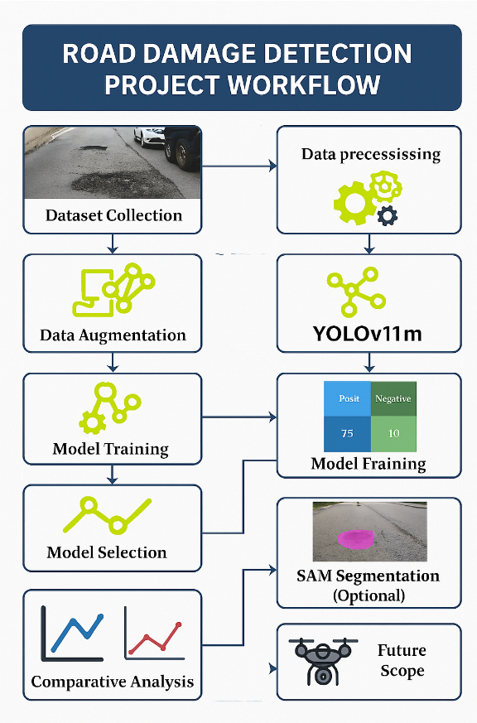

Slide 9

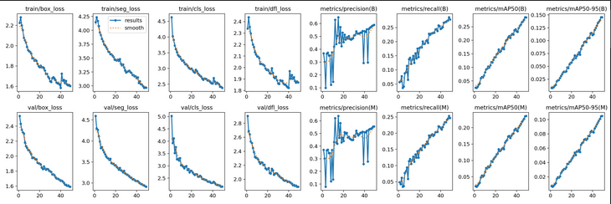
RESULTS
• Validation Losses:
– Box loss: 1.59
– Segmentation loss: 2.91
– Classification loss: 2.15
– DFL loss: 1.88
• Learning Rate: 6.2 × 10−5
Training performance -
• Final Training Losses:
– Box loss: 1.60
– Segmentation loss: 2.91
– Classification loss: 2.15
– DFL loss: 1.86
Precision, Recall, and mAP –
• Precision (B): 0.589
• Recall (B): 0.279
• mAP@50 (B): 0.284
• mAP@50-95 (B): 0.145

Slide 10
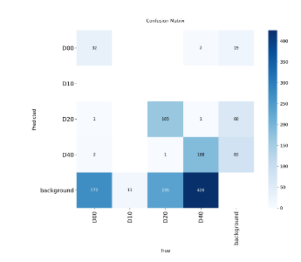
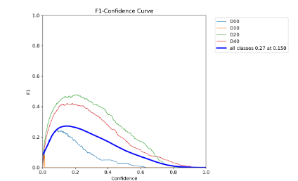
Confusion Matrix: Strong detection accuracy for D20 (Alligator cracks) and D40 (Potholes), with slight confusion between D00 and D10 (fine cracks).
PR Curves: PR and F1 curves show higher precision for D20/D40, while D00 (thin cracks) shows lower recall due to low visibility and narrow width

Slide 11
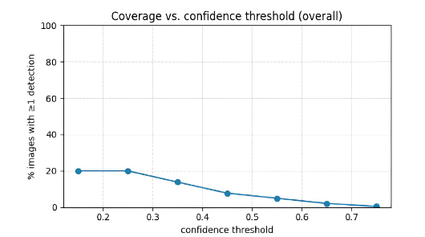
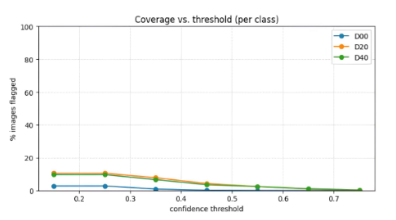
SAM Segmentation Evaluation (Zero-Shot Performance on RDD2020 India)
Evaluated on YOLOv11m-detected regions using SAM segmentation
-Generated precise segmentation masks for D20 (Alligator cracks) and D40 (Potholes) with high area coverage.
-Slight difficulty segmenting D00 (Longitudinal cracks) due to narrow width and low pixel contrast
-Demonstrated pixel-level segmentation accuracy in zero-shot mode, requiring no retraining or labeled masks.

Slide 12
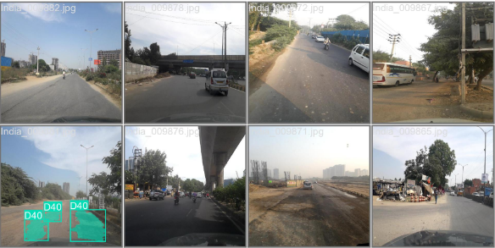
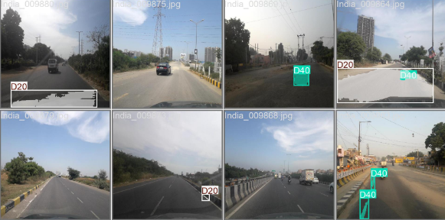
Validation Results Visualization (RDD2020 India)
The integrated YOLOv11m + SAM pipeline accurately detected and segmented road damages (D00–D40) on the RDD2020 (India) validation set
Integration with SAM significantly reduced manual annotation effort and enhanced visual clarity of detected damage regions through pixel-level segmentation
Model successfully localized diverse damage types across varied lighting and road textures.
Validation visualizations generated directly from YOLOv11m detections with SAM overlays applied in zero-shot mode

Slide 13
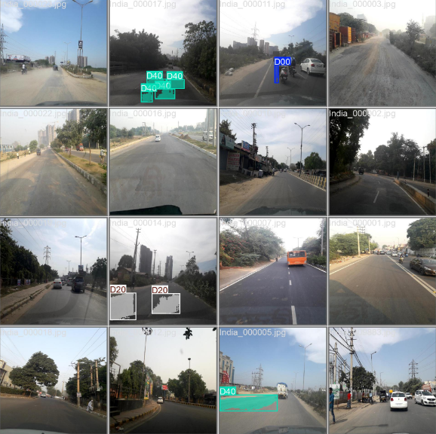

Slide 14
REFERENCE
Maeda, H., Sekimoto, Y., Seto, T., Kashiyama, T., & Omata, H. (2020). Road Damage Detection and Classification Using Deep Neural Networks with Smartphone Images. Computer-Aided Civil and Infrastructure Engineering, 35(3), 213–228. → (RDD2020 Dataset Source)
Kirillov, A., Mintun, E., Ravi, N., Mao, H., Rolland, C., Gustafson, L., et al. (2023). Segment Anything. arXiv preprint arXiv:2304.02643. → (SAM model used for segmentation)
Redmon, J., & Farhadi, A. (2018). YOLOv3: An Incremental Improvement. arXiv preprint arXiv:1804.02767. → (YOLO detection model foundation)
Jocher, G., & Ultralytics Team. (2025). YOLOv11: Real-Time Object Detection Model. Ultralytics GitHub Repository. → (Implementation reference for YOLOv11m)

Slide 15
THANK YOU

